Slide 1
Learning Objective
I will be able to determine the probability, mean and variance of continuous uniform distribution
Success Criteria
At the end of the lesson, I will be able to:
4.2.2 Examine the concepts of a probability density function, cumulative distribution function, and probabilities associated with a continuous random variable given by integrals; examine simple types of continuous random variables and use them in appropriate contexts
4.2.3 Identify the expected value, variance and standard deviation of a continuous random variable and
evaluate them using technology

Slide 2
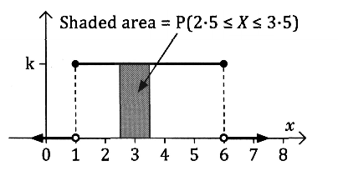
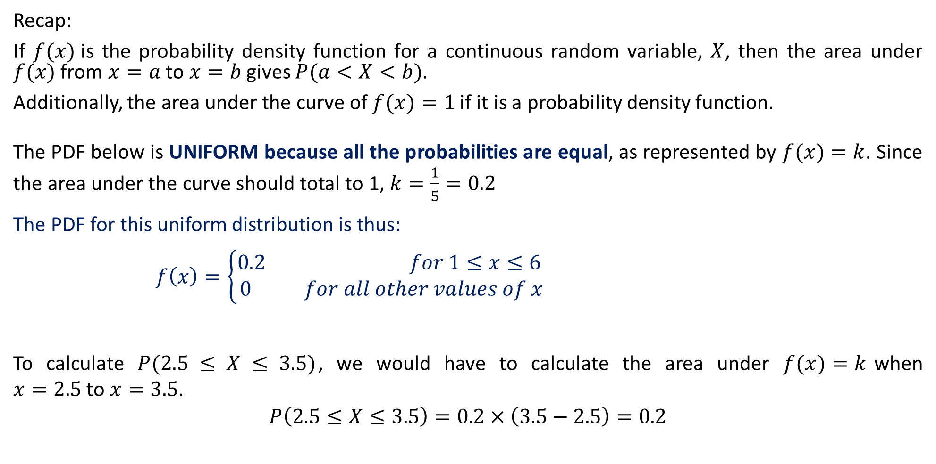
Continuous Uniform Distributions
Recap:
If $f(x)$is the probability density function for a continuous random variable, $X$, then the area under $f(x)$ from $x=a$to $x=b$ gives $P(a<X<b)$.
Additionally, the area under the curve of $f(x)=1$if it is a probability density function.
The PDF below is UNIFORM because all the probabilities are equal, as represented by $f(x)=k$. Since the area under the curve should total to 1, $k=\frac{1}{5}=0.2$
The PDF for this uniform distribution is thus:
$f\left(x\right)=\left\{\begin{aligned}0.2 for 1≤x≤6 \\ 0 for all other values of x\end{aligned}\right.$
To calculate $P(2.5 ≤ X ≤ 3.5)$, we would have to calculate the area under $f(x)=k$when $x=2.5$to $x=3.5$.
$$P\left(2.5≤X≤3.5\right)=0.2×\left(3.5−2.5\right)=0.2$$

Slide 3
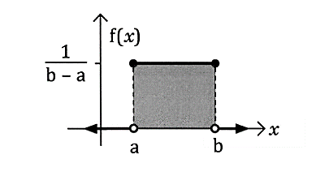
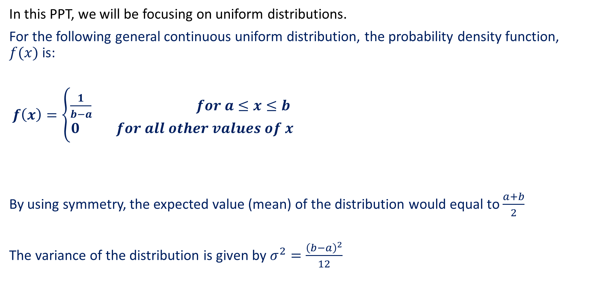
Continuous Uniform Distributions
In this PPT, we will be focusing on uniform distributions.
For the following general continuous uniform distribution, the probability density function, $f(x)$ is:
$f\left(x\right)=\left\{\begin{aligned}\frac{1}{b−a} for a≤x≤b \\ 0 for all other values of x\end{aligned}\right.$
By using symmetry, the expected value (mean) of the distribution would equal to $\frac{a+b}{2}$
The variance of the distribution is given by $σ^{2}=\frac{{\left(b−a\right)}^{2}}{12}$

Slide 4
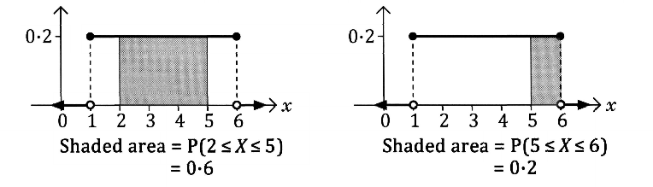
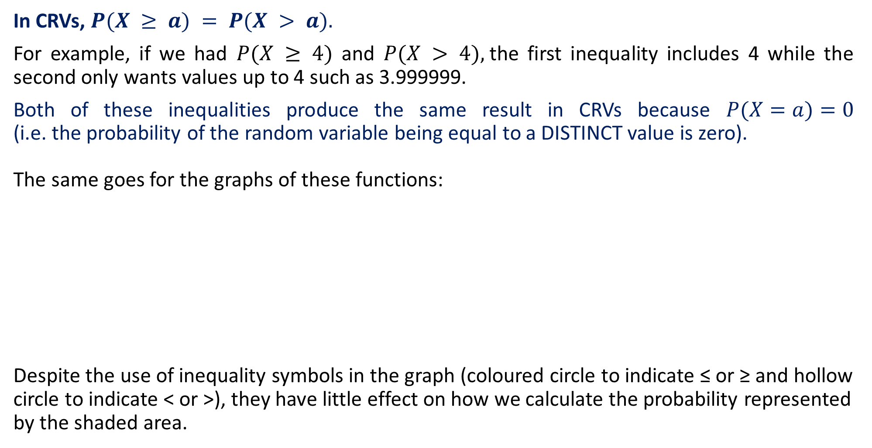
Continuous Random Variables
In CRVs, $P(X ≥ a) = P(X > a).$
For example, if we had $P(X ≥ 4)$ and $P(X > 4),$the first inequality includes 4 while the second only wants values up to 4 such as 3.999999.
Both of these inequalities produce the same result in CRVs because $P(X=a)=0$ (i.e. the probability of the random variable being equal to a DISTINCT value is zero).
The same goes for the graphs of these functions:
Despite the use of inequality symbols in the graph (coloured circle to indicate ≤ or ≥ and hollow circle to indicate < or >), they have little effect on how we calculate the probability represented by the shaded area.

Slide 5
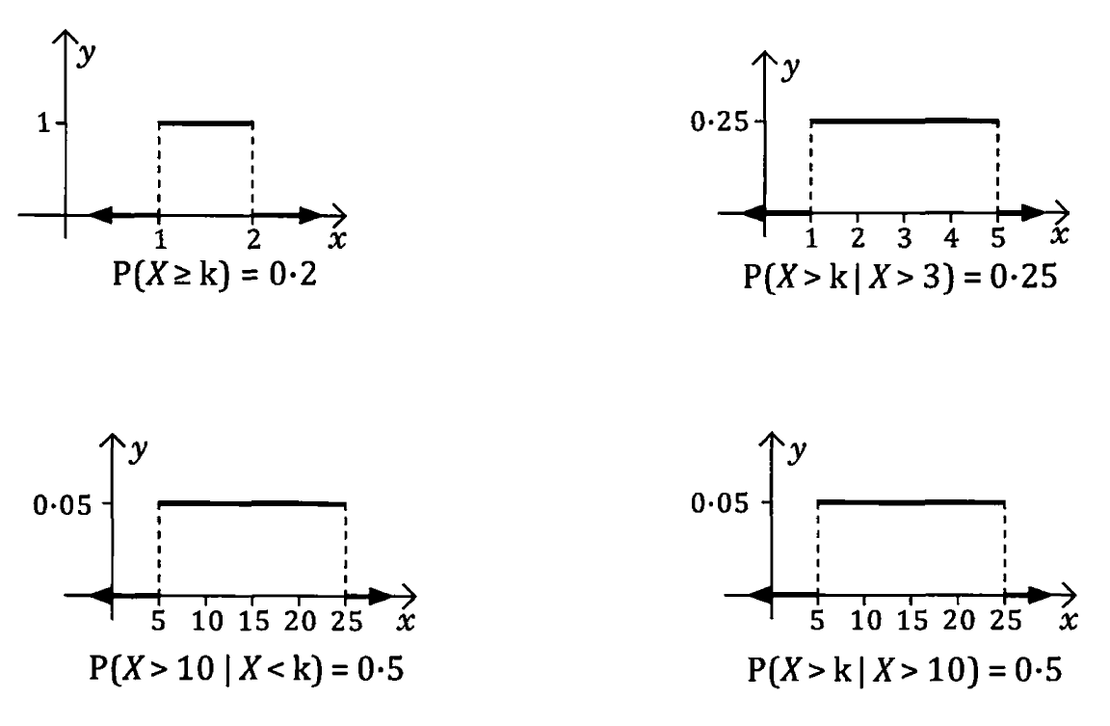

Guided Practice
Given that each of the graphs show a uniform probability distribution, $y=f(x)$, determine the value of $k$ in each case.

Slide 6




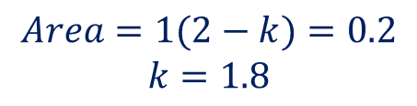



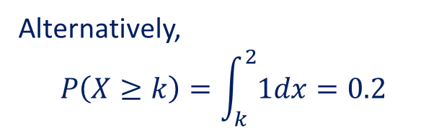
Guided Practice
Given that each of the graphs show a uniform probability distribution, $y=f(x)$, determine the value of $k$ in each case.
$$Area=1(2−k)=0.2$$
$$k=1.8$$
$$k$$
$$2$$
Alternatively,
$$P\left(X≥k\right)=\int_{k}^{2}{1dx}=0.2$$
$${\left[x\right]}_{k}^{2}=0.2$$
$$2−k=0.2$$
$$k=1.8$$
Note that $k$ is the lower bound, since $≥$ is used

Slide 7




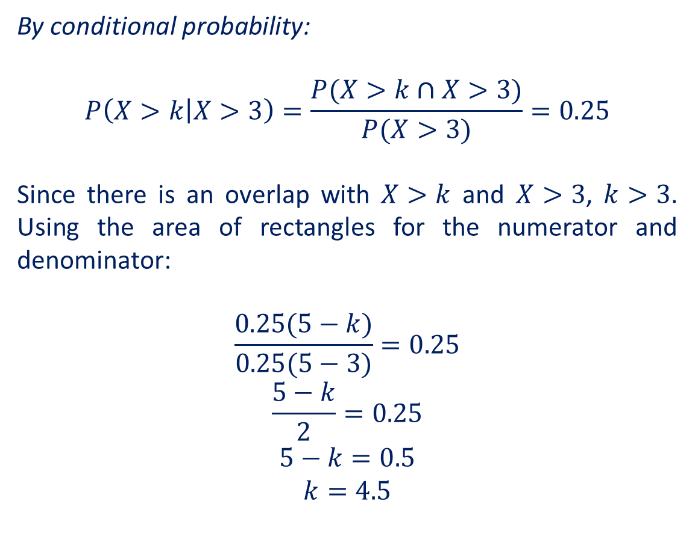
Guided Practice
Given that each of the graphs show a uniform probability distribution, $y=f(x)$, determine the value of $k$ in each case.
By conditional probability:
$$P\left(X>k | X>3\right)=\frac{P(X>k∩X>3)}{P(X>3)}=0.25$$
Since there is an overlap with $X>k$ and $X>3$, $k>3$. Using the area of rectangles for the numerator and denominator:
$$\frac{0.25(5−k)}{0.25(5−3)}=0.25$$
$$\frac{5−k}{2}=0.25$$
$$5−k=0.5$$
$$k=4.5$$
$$3$$
$$k$$
$$5$$
$$5$$

Slide 8




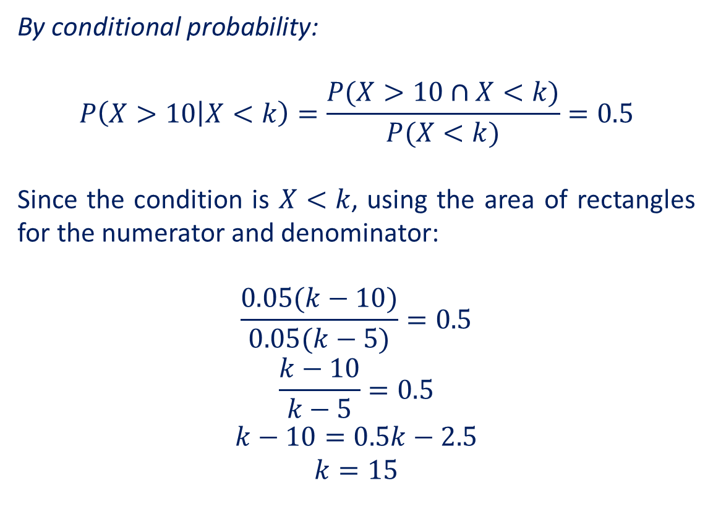
Guided Practice
Given that each of the graphs show a uniform probability distribution, $y=f(x)$, determine the value of $k$ in each case.
By conditional probability:
$$P\left(X>10 | X<k\right)=\frac{P(X>10∩X<k)}{P(X<k)}=0.5$$
Since the condition is $X<k$, using the area of rectangles for the numerator and denominator:
$$\frac{0.05(k−10)}{0.05(k−5)}=0.5$$
$$\frac{k−10}{k−5}=0.5$$
$$k−10=0.5k−2.5$$
$$k=15$$
$$5$$
$$10$$
$$k$$
$$k$$

Slide 9
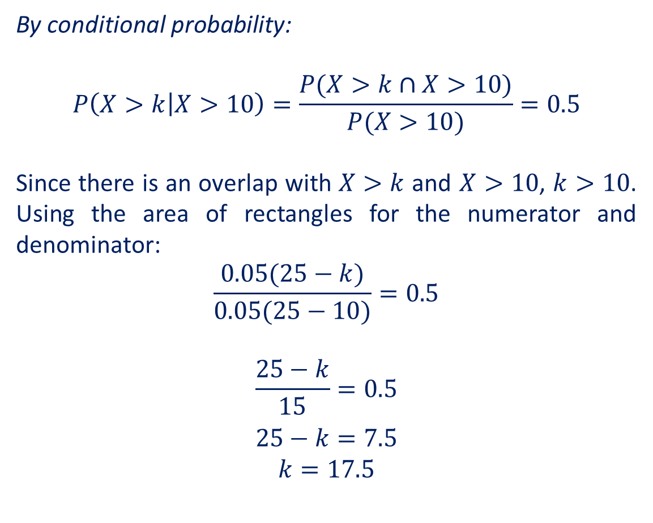
Guided Practice
Given that each of the graphs show a uniform probability distribution, $y=f(x)$, determine the value of $k$ in each case.
By conditional probability:
$$P\left(X>k | X>10\right)=\frac{P(X>k∩X>10)}{P(X>10)}=0.5$$
Since there is an overlap with $X>k$ and $X>10$, $k>10$. Using the area of rectangles for the numerator and denominator:
$$\frac{0.05(25−k)}{0.05(25−10)}=0.5$$
$$\frac{25−k}{15}=0.5$$
$$25−k=7.5$$
$$k=17.5$$

Slide 10
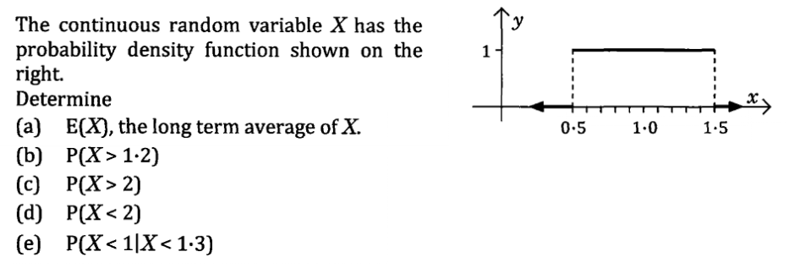
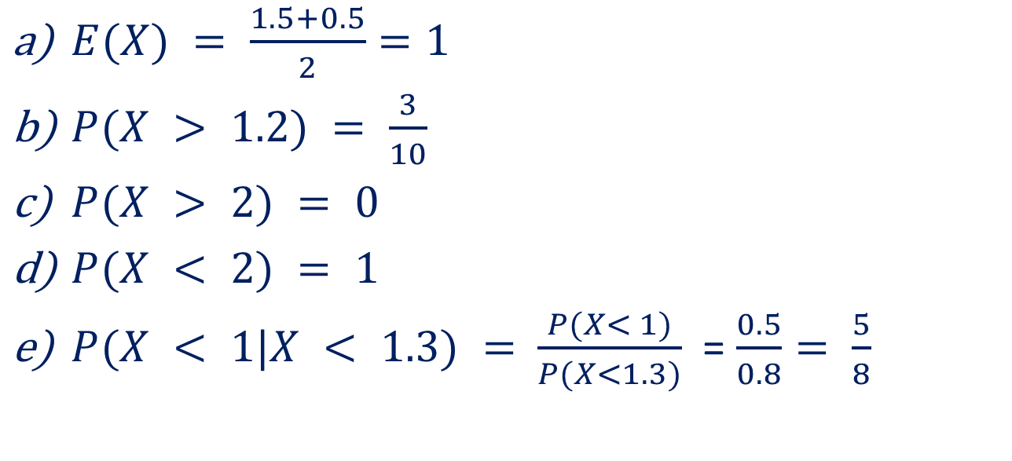
Guided Practice
$E(X) = \frac{1.5+0.5}{2}=1$
$P(X > 1.2) = \frac{3}{10}$
$P(X > 2) = 0$
$P(X < 2) = 1$
$P(X < 1|X < 1.3) =$ $\frac{P(X< 1)}{P(X<1.3)}$ = $\frac{0.5}{0.8}= \frac{5}{8}$

Slide 11
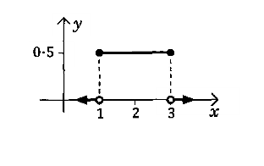
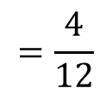
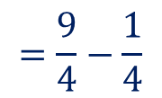
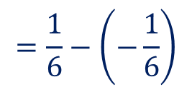
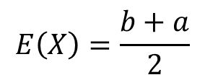
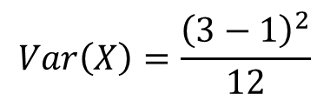
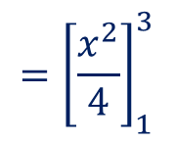
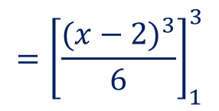
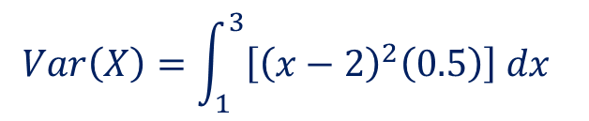
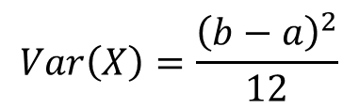
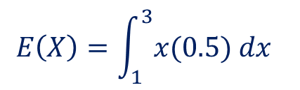

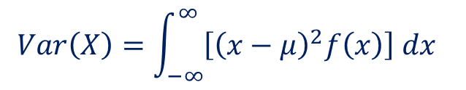
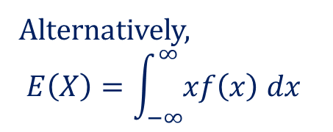
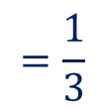
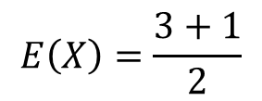
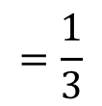

Guided Practice
Determine the expected value and variance for the following probability distribution function.
$$E\left(X\right)=\frac{b+a}{2}$$
$$Var\left(X\right)=\frac{{\left(b−a\right)}^{2}}{12}$$
$$E\left(X\right)=\frac{3+1}{2}$$
$$Var\left(X\right)=\frac{{\left(3−1\right)}^{2}}{12}$$
$$=2$$
$$=\frac{4}{12}$$
Alternatively,
$$E\left(X\right)=\int_{−∞}^{∞}{xf\left(x\right) dx}$$
$$Var\left(X\right)=\int_{−∞}^{∞}{\left[{\left(x−μ\right)}^{2}f\left(x\right)\right] dx}$$
$$=\frac{1}{3}$$
$$Var\left(X\right)=\int_{1}^{3}{\left[{\left(x−2\right)}^{2}\left(0.5\right)\right] dx}$$
$$E\left(X\right)=\int_{1}^{3}{x(0.5) dx}$$
$$={\left[\frac{{(x−2)}^{3}}{6}\right]}_{1}^{3}$$
$$={\left[\frac{x^{2}}{4}\right]}_{1}^{3}$$
$$=\frac{9}{4}−\frac{1}{4}$$
$$=\frac{1}{6}−\left(−\frac{1}{6}\right)$$
$$=\frac{1}{3}$$
$$=2$$

Slide 12
Independent Practice
Complete Worksheets

